Slide 1

Using the Healthy Start form to predict adverse neonatal outcomes based on risk factors
Silvio Martinez
Mentors: Dr. Diana Montoya-Williams, Dr. Lindsay Thompson
Department of Pediatrics & Neonatology

Slide 2
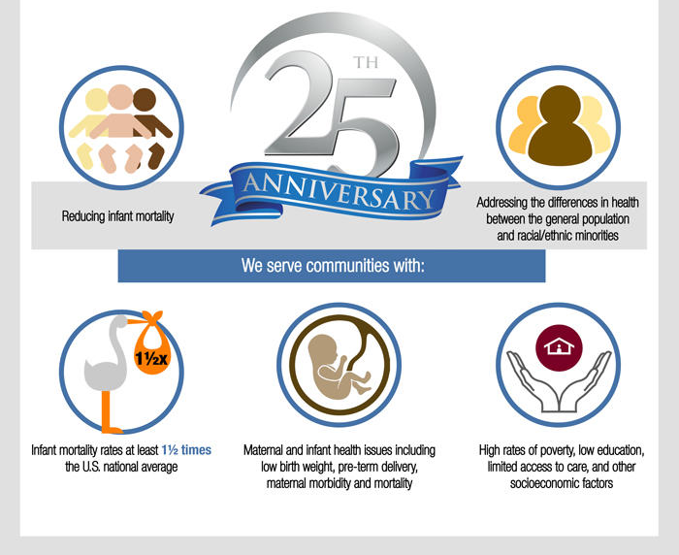

The Healthy Start Program
Notes:
The Healthy Start program was created in 1991 by the Health resources & Services administration with the aim of improving the health of American mothers before, during and after pregnancy. It began as a demonstration project in 15 communities that had an IMR 1.5 to 2.5x the national average. By 2012, it has grown to to 105 Healthy Start projects in 39 states, Puerto Rico and Washington, DC.
A screening tool, self-reported form, to identify women at-risk, and provide comprehensive resources to address those at risk
Healthy start name
At its core, the Program goals include: (1) a reduction of racial and ethnic disparities in access to and utilization of health services, (2) an improved local health care system, and (3) an increased community voice in health care decisions.

Slide 3
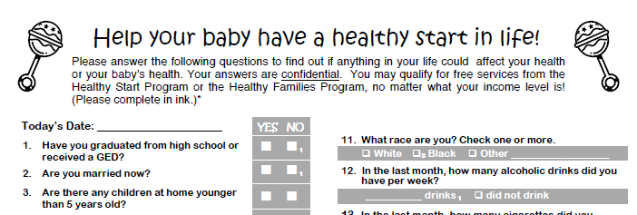
Universal Screening
Care Coordination
Community-Based System Management
Prenatal maternal screen & infant screen immediately after birth
Development of individual plan of care and linking of services
Community-based prenatal and infant health care coalitions
Notes:
The standardized prenatal screening instrument for pregnant women includes a series of questions focusing on medical, environmental and psychosocial factors that are known, based on documented research, to be associated with increased risk of adverse outcomes.
2) Healthy Start provides a personal Care Coordinator to assist the mother with services throughout her prenatal care and after the birth of her baby. Services may include: Breastfeeding Education and Support, Parenting Education and Support, Tobacco Free Education and Support, Psychosocial Counseling, Childbirth Education, Women’s Health Education and Support.
3) Community-based prenatal and infant health care coalitions are responsible for allocating funds, selecting providers to deliver specific services and monitoring the performance of providers to ensure quality care and focus on improved outcomes.

Slide 4
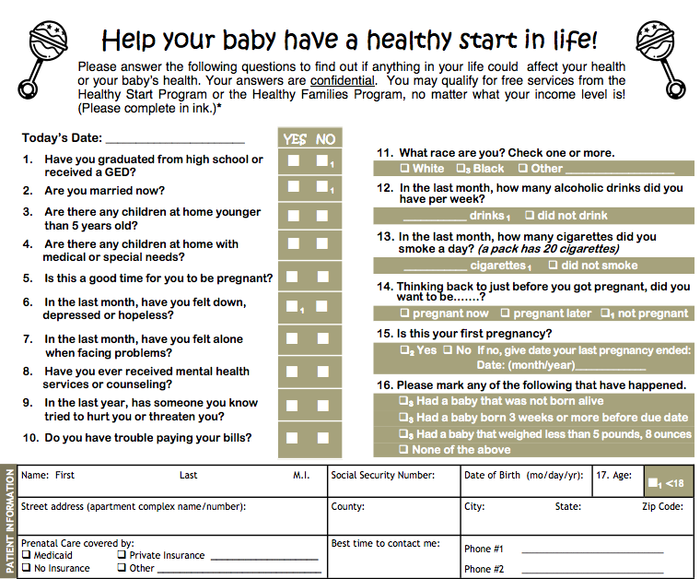
Notes:
HS>6, at risk
Question 9: has someone tried to hurt you or threaten you

Slide 5
Healthy Start Literature to date
National literature has focused on implementation outcomes and uptake of services as reported by individual Healthy Start projects around the country¹
Individual level Healthy Start initiatives have documented:
Improved preterm birth (PTB) rates²
<37 weeks, often low birth weight (<2500g)
Improved low birth weight (LBW) rates³
<2500g
Decreased sexually transmitted infection⁴
Sensitivity of the screening tool in identifying women at increased risk of poor birth outcomes is poor as of 2008⁵
47.1% for LBW
40.9% for PTB
¹Drayton et al., 2015
²Salihu et al., 2009
³Kothari et al, 2014
⁴Livingwood et al., 2010
⁵Thompson et al., 2010

Slide 6
Specific aims
Describe differences in self-reported risk factors between a cohort of mothers who experienced an adverse birth outcome and healthy control dyads
Describe how women of different races/ethnicity who delivered preterm or low birth weight infants answer the screening tool
Develop a predictive model for preterm birth and LBW based on self-reported Healthy Start risk factors
Notes:
Dyad- baby and mother together; mother-child dyad

Slide 7
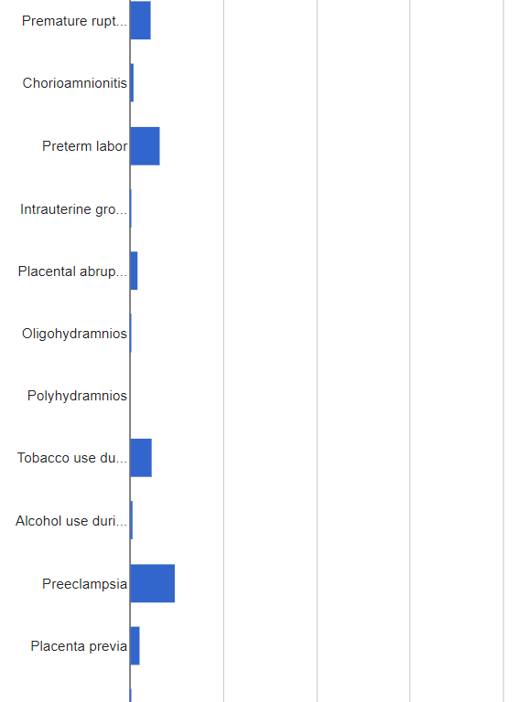
Design & Variables of interest
Retrospective cohort study: All maternal-infant dyads where infant was born at UF Health in 2015
Predictor Variable: Response to the Healthy Start form
Outcome of Interest: Adverse Birth Outcome
Defined as preterm birth (< 37 weeks) or low birth weight (< 2500 grams)
Maternal Biomedical Covariates for PTB/LBW:
Fetal factors
Maternal prenatal factors
Maternal intrapartum factors
Notes:
Fetal factors: intrauterine growth restriction
Maternal prenatal factors: oligohydramnios, polyhydramnios, nicotine use during pregnancy, drug use during pregnancy, preeclampsia, uterine implantation abnormalities (accreta, previa, percreta
Maternal intrapartum factors: premature rupture of membranes, chorioamnionitis, preterm labor, placental abruption

Slide 8
Data collection to date
1078 Infants Screened thus far
Excluded:
- Duplicate EMR (n=11)
- No birth encounter (n = 454)
- Outborn (n= 75)
- Twin or congenital anomaly (n=88)
457 Maternal-Infant Dyads
504 Received prenatal care at UF (Table 1)
312with a Healthy Start form present (Table 2)

Slide 9
Key differences between cohorts
 | 2015 Birth Cohort n=372 | Healthy Controls (≥37w & ≥2.5 kg) n=242 | Adverse Birth Outcome: Low birth weight or Preterm (<2.5 kg or < 37 weeks) n=37 | p-value
Birth weight (grams) | 3160 (SD 702) | 3368 (SD 417) | 1856 (SD 731) | <.001
Gestational age (weeks) | 38 (SD 3) | 39 (SD 1.2) | 32 (SD 4.2) | <.001
Gender (% male) | 46% | 45% | 53% | ns
Maternal age (years) | 28 (6) | 28 (5.9) | 28 (6.5) | ns
Maternal Race: White | 57% | 50.8% | 29.0% | <.05
Black | 25% | 23.6% | 18.3% | ns
Asian | 4% | 3.3% | 0.8% | ns
Other | 13% | 14.4% | 3.8% | <.05
Hispanic | 12% | 13.3% | 3.8% | <.05
Healthy Start form present | 73% | 73% | 71% | ns
Healthy Start Score | 4.5 (SD 3) | 4.1 (SD 3) | 7(4) | <.0001
Notes:
In here,
Comparing Healthy control to Low birth weight or preterm joint cohort
For adverse: birth weight significantly lower, gestational age (explain), HS Score higher for adverse
Not significant: gender, maternal age, some race, and whether they have HS form
Race: those at risk less white, and more other
Why is the percentages of adverse birth by race not adding up?
Seems that black and other (race) increase in adverse, so follow-up
Ethnicity: seems Hispanic drops for adverse, why?
Going to use EMR to find races

Slide 10
Healthy Start Self-Reported Risk Factor | Healthy Control (n =233) | Adverse Outcome Group (n=35) | p-value* | Scored by HS Program?
Have not graduated from high school | 15% | 14.3% | ns | Yes
Unmarried | 46.4% | 57.1% | ns | Yes
Children < 5 years at home | 54.8% | 57.1% | ns | No
Special needs children at home | 3.9% | 13.9% | <.05 | No
Not a good time for me to be pregnant | 10.1% | 29.4% | <.05 | No
Felt down or hopeless in last month | 12.6% | 22.9% | ns | Yes
Felt alone when facing problems | 7.4% | 11.4% | ns | No
Ever received mental health services | 16.5% | 22.9% | ns | No
Have trouble paying bills | 14.8% | 28.6% | <0.05 | No
This is my first pregnancy | 25.7% | 28.6% | ns | Yes
I am less than 18 | 2.2% | 5.9% | ns | Yes
Inter-pregnancy interval is < 18 months | 24.5% | 23.3% | ns | Yes
Have an illness with ongoing medical care | 19% | 55.6% | <.05 | Yes
* Univariate analyses only.
Notes:
highlighted ones are not scored and yet significant

Slide 11
NEXT STEPS
Finish collecting data for births over one calendar year.
Build adjusted predictive models for an adverse birth outcome using Healthy Start responses
Ongoing QI efforts to integrate the Healthy Start form into the EMR at UF Health
Notes:
Which questions make the model stronger?
Do these align with the questions that garner women points for referral?
I’ve been collaborating on a prematurity working group at the Health outcomes & biomedical informatics dept at UF on a planned R-level grant proposal

Slide 13
Logistic Model
Aim: Find the best predictive model for an adverse birth outcome based on responses to the HS Form
Also, determine if some questions should be scored
One option: Association between HS score > 6 (exposure) and adverse birth (outcome)
Account for biomedical risk factors with 1 variable (whether they have biomedical risk or not)
Notes:
- Risk factor is binary because none seems to contribute beyond other variables,

Slide 15
Statistical Questions/Considerations
Are some “biomedical risk factors” more predictive of adverse outcome than others?
e.g. Preeclampsia
Add variables to model (forward regression)
Some “biomedical risk factors” may be associated with the HS score variable
Interaction term?
How to determine which questions should be scored and what score to give?
Find associations & compare questions (chi square)
Test variables: stepwise regression method (elimination)
Notes:
preeclampsia – protein in urine and high blood pressure , occurs 20 weeks after pregnancy usually

Slide 16
Additional Research Questions
Are some “biomedical risk factors” more predictive of adverse outcome than others?
e.g. Preeclampsia: one study found hypertensive disorders effect on LBW more significant than placental previa, oligohydramnios, PROM (1)
Add variables to model (forward regression)
What is the risk for Hispanic vs. non-Hispanic dyads? Why does there appear to be no risk?
Lack of controlling for income in one study (2)
How much each question should be scored
Following up with women to see how they benefited from the program
Medicaid and association with decreased LBW and other questions on form (2)
Notes:
https://www.ncbi.nlm.nih.gov/pmc/articles/PMC3596750/ (Maternal risk factors for low birth weight for term births in a developed region in China); that hypertensive disorders, including gestational hypertension and preeclampsia, might be one of the most important risk factors for term LBW.; also associated with education (primary), anemia, and fetal distress
Risk factor for low birth weight infants…. Tierney-Gumaer and Reifsnider;

Slide 17
Acknowledgement
Diana Montoya-Williams, MD, Pediatrician & Neonatology Fellow

Slide 18
Questions?

Slide 19
Key differences between cohorts
 | 2015 Birth Cohort n=279 | Healthy Controls (≥37w & ≥2.5 kg) n=242 | Adverse Birth Outcome: Low birth weight or Preterm (<2.5 kg or < 37 weeks) n=37 | p-value
Birth weight (grams) | 3162**** (SD 659) | 3349 (SD 408) | 1937*** (SD 683) | <.001
Gestational age (weeks) | 38**** (SD 2.8) | 39 (SD 1.2) | 33**** (SD 3.8) | <.001
Gender (% male) | 47% | 45% | 57% | ns
Maternal age (years) | 28 (5.8) | 28 (5.7) | 29 (6.8) | ns
Maternal Race: White | 58.1% | 59.5% | 49.0% | ns
Black | 27.2% | 25% | 41% | 0.0796
Asian | 2.87% | 2.89% | 2.7% | ns
Other | 10.0% | 10.3% | 8.1% | ns
Hispanic | 11.8% | 12.8% | 5.41% | ns (Fisher’s)
Healthy Start form present | 73% | 73% | 71% | ns
Healthy Start Score | 4.5 (SD 3.5) | 4.1 (SD 3.3) | 6.9 (SD 3.8) | <.001
Notes:
Adjusted: now lbw and preterm 1 group; now excluding those with duplicate EMRs;
Are we keeping the HS form present characteristic?
****=<.0001; ***= less than .001; **=<.01; *= <.05; . is <.20
For black adverse vs controls, may be .08 p-value because of difference in sample size, may be an association however (8% still small), keep this in mind
Comparing Healthy control to Low birth weight or preterm joint cohort
For adverse: birth weight significantly lower, gestational age (explain), HS Score higher for adverse
Not significant: gender, maternal age, some race, and whether they have HS form
Race: those at risk less white, and more other
Why is the percentages of adverse birth by race not adding up?
Seems that black and other (race) increase in adverse, so follow-up
Ethnicity: seems Hispanic drops for adverse, why?
Going to use EMR to find races

Slide 20
Healthy Start Self-Reported Risk Factor | Healthy Control (n =242) | Adverse Outcome Group (n=37) | p-value* | Scored by HS Program?
Have not graduated from high school |  |  |  | Yes
Unmarried |  |  |  | Yes
Children < 5 years at home |  |  |  | No
Special needs children at home | 4.13% | 16.2% | <.05 | No
Not a good time for me to be pregnant | 10.3% | 27.0% | <.01 | No
Felt down or hopeless in last month |  |  |  | Yes
Felt alone when facing problems |  |  |  | No
Ever received mental health services |  |  |  | No
Have trouble paying bills | 14.9% | 27.0% | <0.10 | No
This is my first pregnancy |  |  |  | Yes
I am less than 18 |  |  |  | Yes
Inter-pregnancy interval is < 18 months |  |  |  | Yes
Have an illness with ongoing medical care |  |  |  | Yes
* Univariate analyses only.
Notes:
Trouble paying bills, not less than .05

